Slide 1
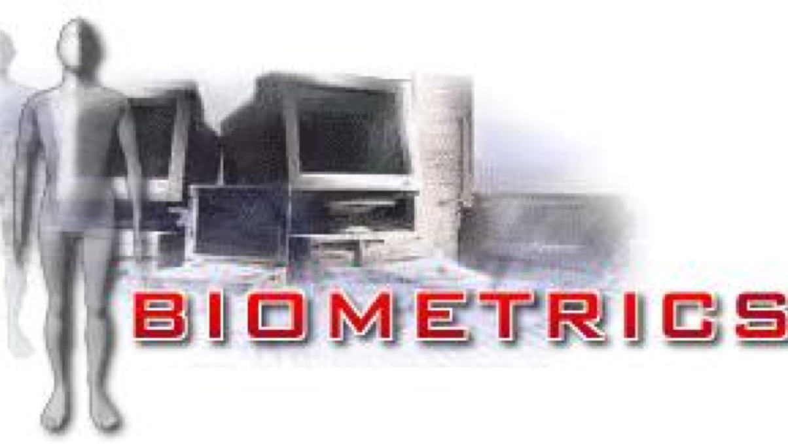
Biometrics System Concepts
Course holder: Dirk Vandermeulen
(dirk.vandermeulen@kuleuven.be)
Teaching Assistant: Balder Croquet
(Balder.Croquet@kuleuven.be)

Slide 2
Definition
Biometrics: identifying/authenticating an individual in an automated, reliable and fast way using unique physiological or behavioral characteristics
Physiological: static
morphometric (shape): face
biological: DNA
Behavioral: dynamic
the way we walk, speak, write
https://www.gemalto.com/govt/inspired/biometrics#

Slide 3
Biometrics and Biometrics
In practice, we often abbreviate the term “biometric authentication” as
“biometrics”, although the latter term has been historically used to mean
the branch of biology that deals with its data statistically and by quantitative
analysis.
So “biometrics”, in this context, is the use of computers to recognize
people, despite all of the across-individual similarities and within-individual
variations.
Biometric Systems: technology, design and system evaluation, Wayman et al (Eds), Springer, 2005

Slide 4
Main biometric identifiers
Physiologic
Face (visible, thermal)
Fingerprint – Palmprint
Hand Geometry
Iris - Retina
Ear
Behavioral
Gait
Signature (static, dynamic)
Voice – Speaker recognition

Slide 5
Civil Applications
Social security card
National ID card
International passport
1 billion ePassports mid-2017
Driver’s license
https://www.bayometric.com/biometrics-civil-identification/

Slide 6
Commercial Applications
Automated Teller Machines (ATM)
Credit card (e-commerce)
Cellular/Mobile (GSM)
Access control
Prison
PC/network
Time and attendance monitoring

Slide 7
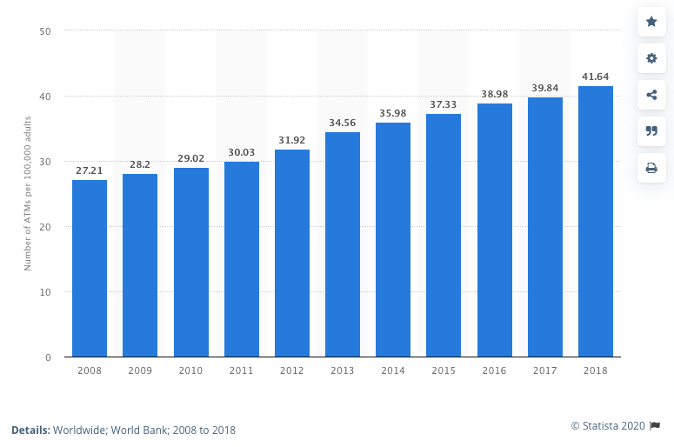
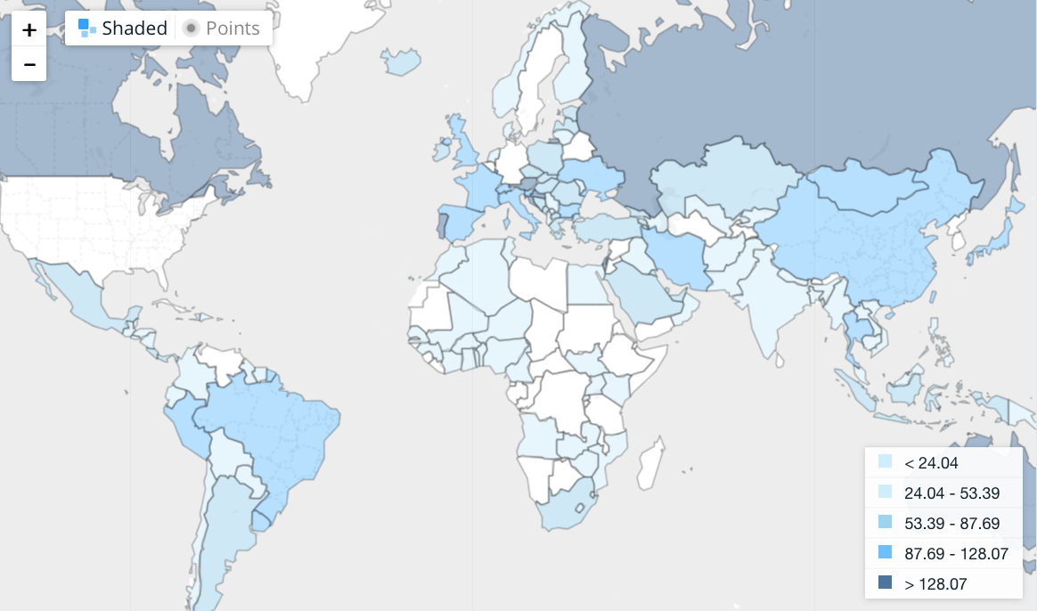
Number of automated teller machines (ATM) per 100.000 adults
2020: 4.3 million units worldwide

Slide 8

Number of non-cash transactions worldwide from 2013 to 2022, by region (in billions)
Number of cashless transactions worldwide 2013-2022, by region
Note: Worldwide; 2013 to 2017
Further information regarding this statistic can be found on page 31.
Source(s): Capgemini; ECB; BIS; ID 265767
5
Overview

Slide 9
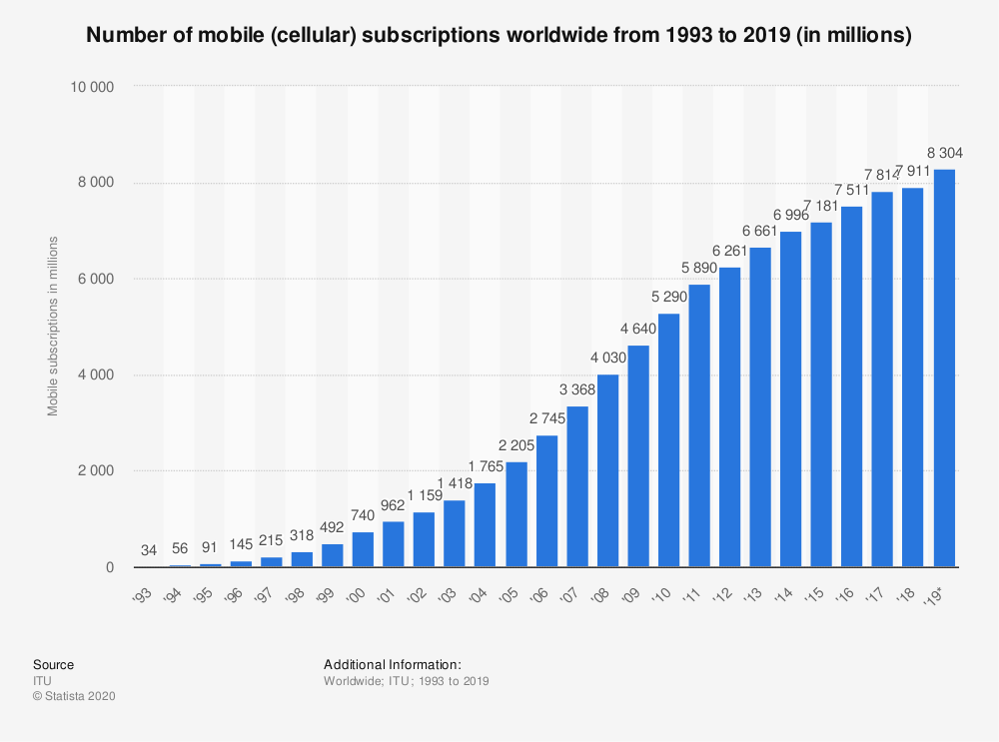
# cell phone subscriptions

Slide 10
Surveillance

Slide 11
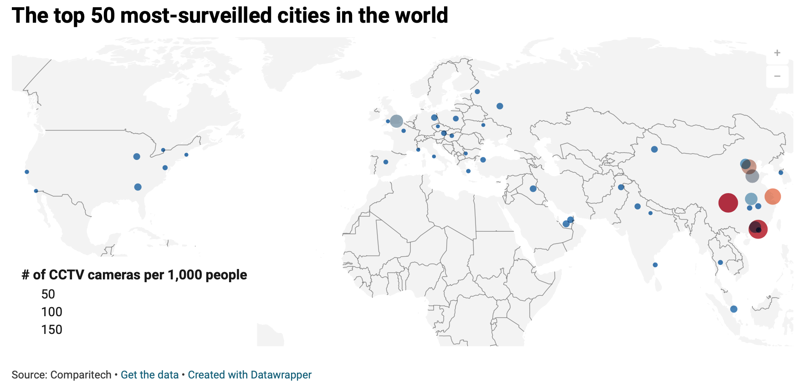
Surveillance
https://www.comparitech.com/vpn-privacy/the-worlds-most-surveilled-cities/

Slide 12
The 20 most-surveilled cities in the world
1. Chongqing, China – 2,579,890 cameras for 15,354,067 people = 168.03 cameras per 1,000 people
… (China)
6. London, England (UK) – 627,707 cameras for 9,176,530 people = 68.40 cameras per 1,000 people
… (China)
10. Atlanta, Georgia (US) – 7,800 cameras for 501,178 people = 15.56 cameras per 1,000 people
11. Singapore – 86,000 cameras for 5,638,676 people = 15.25 cameras per 1,000 people
12. Abu Dhabi, UAE – 20,000 cameras for 1,452,057 people = 13.77 cameras per 1,000 people
13. Chicago, Illinois (US) – 35,000 cameras for 2,679,044 people = 13.06 cameras per 1,000 people
14. Urumqi, China – 43,394 cameras for 3,500,000 people = 12.40 cameras per 1,000 people
15. Sydney, Australia – 60,000 cameras for 4,859,432 people = 12.35 cameras per 1,000 people
16. Baghdad, Iraq – 120,000 cameras for 9,760,000 people = 12.30 cameras per 1,000 people
17. Dubai, UAE – 35,000 cameras for 2,883,079 people = 12.14 cameras per 1,000 people
18. Moscow, Russia – 146,000 cameras for 12,476,171 people = 11.70 cameras per 1,000 people
19. Berlin, Germany – 39,765 cameras for 3,556,792 people = 11.18 cameras per 1,000 people
20. New Delhi, India – 179,000 cameras for 18,600,000 people = 9.62 cameras per 1,000 people

Slide 13
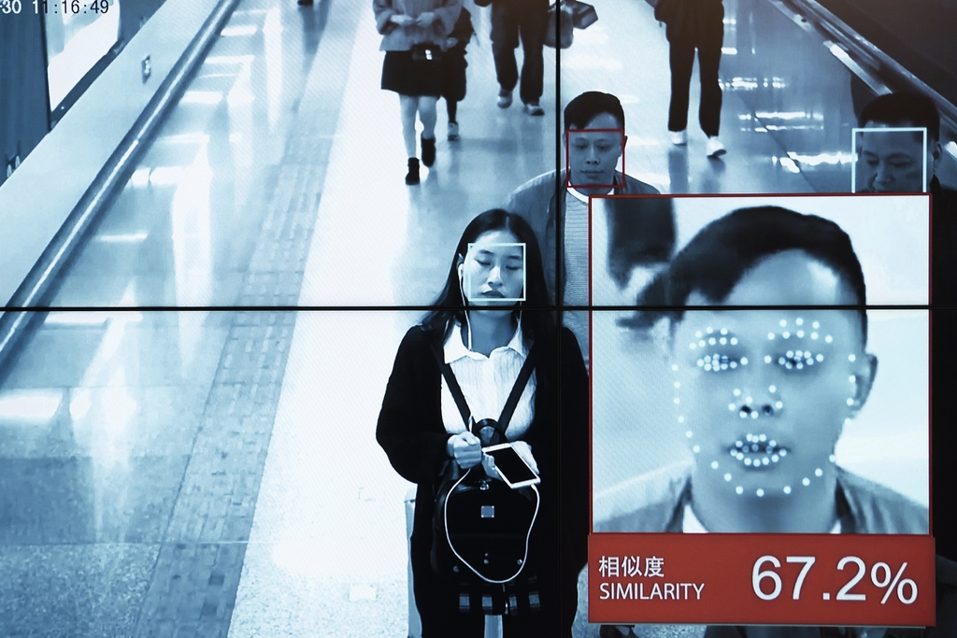
Surveillance

Slide 15
CHINA INVENTS SUPER SURVEILLANCE CAMERA THAT CAN SPOT SOMEONE FROM CROWD OF THOUSANDS
https://www.independent.co.uk/life-style/gadgets-and-tech/news/china-surveillance-camera-facial-recognition-privacy-a9131871.html

Slide 16
Forensic Applications: Terrorist Surveillance

Slide 17
Forensic Applications: criminal cases
The Lindbergh Kidnapping On March 1, 1932, Charles Lindbergh Jr., the 20-month-old son of the famous aviator, was kidnapped, and although a ransom of $50,000 was paid, the child was never returned. His body was discovered in May just a few miles from his home. Tracking the circulation of the bills used in the ransom payment, authorities were led to Bruno Hauptmann, who was found with over $14,000 of the money in his garage. While Hauptmann claimed that the money belonged to a friend, key testimony from handwriting analysts matched his writing to that on the ransom notes.

Slide 18
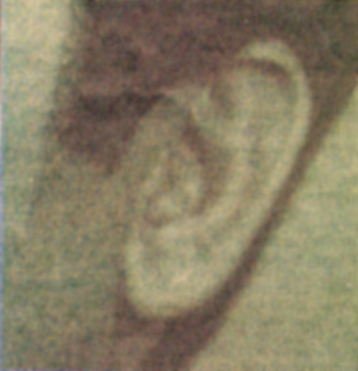
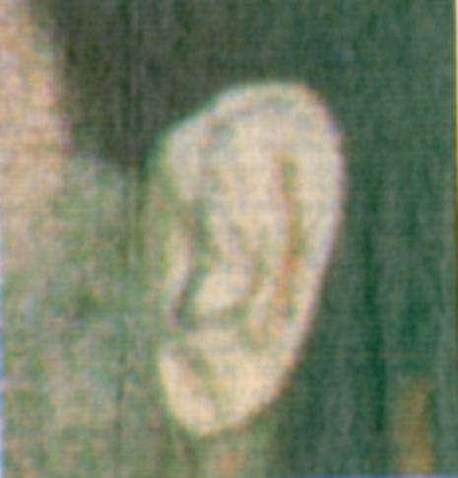
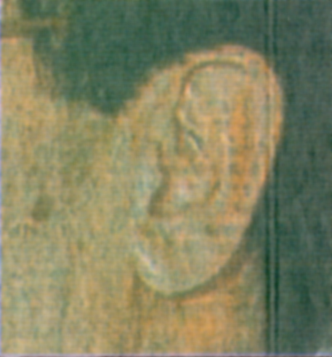
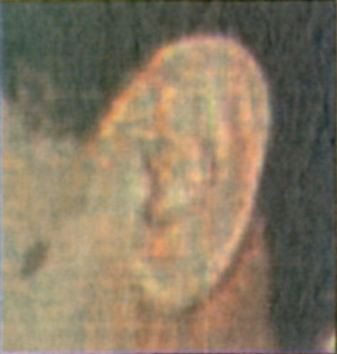
Forensic Applications
Dr. Dieter Buhmann, Instituet fuer Rechtsmedizin, Universiteit Homburg, Saarland

Slide 19
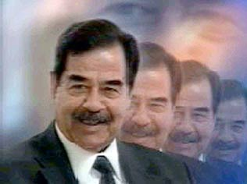
Forensic Applications
Foto: ZDF
See the video on ZDF on 26/09/2002.
See also http://www.uni-saarland.de/verwalt/presse/campus/2002/4/08-hussein.html
https://www.demorgen.be/nieuws/wil-de-echte-saddam-dan-nu-opstaan~b419fc4c/
8

Slide 20
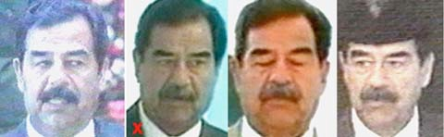
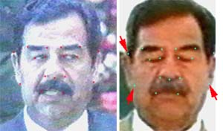
Forensic Applications
Foto: ZDF
9

Slide 21
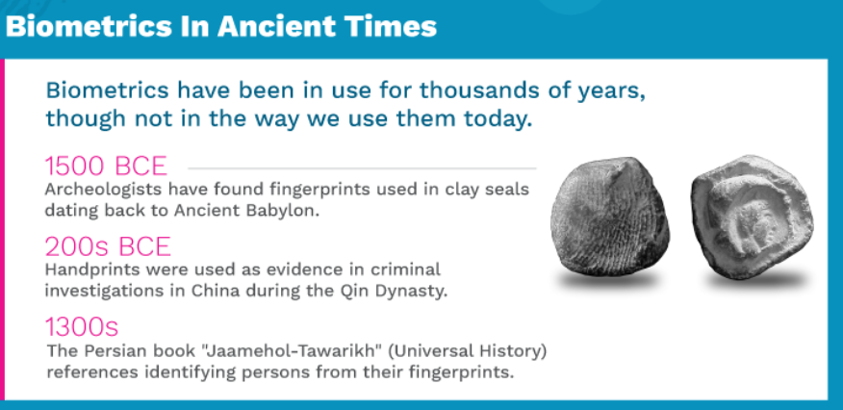
History of biometrics
https://info.veridiumid.com/identity-through-the-ages

Slide 22
History of biometrics
1858 – First systematic capture of hand images for identification purposes is recorded
Sir William Herschel, working for the Civil Service of India, recorded a handprint on the back of a contract for each worker to distinguish employees from others who might claim to be employees when payday arrived. This was the first recorded systematic capture of hand and finger images that were uniformly taken for identification purposes.
https://www.biometricupdate.com/201802/history-of-biometrics-2

Slide 23
History of biometrics
1870 – Bertillon develops anthropometries to identify individuals
Alphonse Bertillon developed “Bertillonage” or anthropometries, a method of identifying individuals based on detailed records of their body measurements, physical descriptions and photographs. Repeat criminal offenders often provided different aliases when arrested. Bertillon noted that although they could change their names, they could not change certain elements of their bodies. Police authorities throughout the world used his system, until its use quickly faded when it was discovered that some people shared the same measurements.

Slide 24
History of biometrics
1896 – Henry develops a fingerprint classification system
Sir Edward Henry, Inspector General of the Bengal Police, was in search of a method of identification to implement concurrently or to replace anthropometries. Henry consulted Sir Francis Galton regarding fingerprinting as a method of identifying criminals. Once the fingerprinting system was implemented, one of Henry’s workers, Azizul Haque, developed a method of classifying and storing the information so that searching could be performed easily and efficiently. Sir Henry later established the first British fingerprint files in London. The Henry Classification System, as it came to be known, was the precursor to the classification system used for many years by the Federal Bureau of Investigation (FBI) and other criminal justice organizations that perform tenprint fingerprint searches.
In July 1901 the Fingerprint Branch at New Scotland Yard (Metropolitan Police) was created using the Henry System of Fingerprint Classification.

Slide 25
History of biometrics
1903 – NY State Prisons begin using fingerprints
“The New York Civil Service Commission established the practice of fingerprinting applicants to prevent them from having better qualified persons take their tests for them.”
This practice was adopted by the New York state prison system where fingerprints were used “for the identification of criminals in 1903.
In 1904 the fingerprint system accelerated when the United States Penitentiary at Leavenworth, Kansas, and the St. Louis, Missouri Police Department both established fingerprint bureaus.
During the first quarter of the 20th century, more and more local police identification bureaus established fingerprint systems.
The growing need and demand by police officials for a national repository and clearinghouse for fingerprint records led to an Act of Congress on July 1, 1921, establishing the Identification Division of the FBI.”

Slide 26
History of biometrics
1969 – FBI pushes to make fingerprint recognition an automated process
In 1969, the Federal Bureau of Investigation (FBI) began its push to develop a system to automate its fingerprint identification process, which was quickly becoming overwhelming and required many man-hours.
The FBI contracted the National Institute of Standards and Technology (NIST) to study the process of automating fingerprint identification.
NIST identified two key challenges:
scanning fingerprint cards and identifying minutiae
comparing and matching lists of minutiae.

Slide 27
History of biometrics
1974- First commercial hand geometry systems become available
1976 – First prototype system for speaker recognition is developed
1977 – Patent is awarded for acquisition of dynamic signature information
1985 – Patent for hand identification is awarded
1988 – Eigenface technique is developed for face recognition
1991 – Face detection is pioneered, making real time face recognition possible
1994 – First iris recognition algorithm is patented

Slide 28
Variation in biometric applications
Operational goals
Search for known individuals
Search for unknown individual
Verify a claimed identity
Verify an unclaimed identity
Verify that the individual has no identity in the system at all
Biometric Systems: technology, design and system evaluation, Wayman et al (Eds), Springer, 2005

Slide 29
Variation in biometric applications
Single/multiple samples
1-to-N: Some systems search one or multiple submitted samples against a large database of millions of previously stored “templates” – the biometric data given at the time of enrolment.
1-to-1: Some systems search one or multiple samples against a database of a few “models” – mathematical representations of the signal generation process created at the time of enrolment.
Some systems compare submitted samples against models of both the claimed identity and impostor identities.
Some systems search one or multiple samples against only one “template” or “model”.
Biometric Systems: technology, design and system evaluation, Wayman et al (Eds), Springer, 2005

Slide 30
Variation in biometric applications
Application environments
outdoors or indoors
supervised or unsupervised
with people trained or not trained in the use of the acquisition device.
Biometric Systems: technology, design and system evaluation, Wayman et al (Eds), Springer, 2005

Slide 31
Personal recognition: 2 modi operandi
Associate a particular individual with an identity
Verification/authentication: verifying a claimed identity
“Am I who I claim I am?”
Identification: determining the identity of a given person from a database of persons known to the system
“Who am I?”
10

Slide 32
Positive vs negative identification
positive identification:
the user attempts to positively identify himself to the system without explicitly claiming an identity
“Are you someone who is known to the system?”
negative identification (screening):
the user is considered to be concealing his true identtity (either explicitly or implicitly) from the system
“Are you who you say you are not?”
Biometric Systems: technology, design and system evaluation, Wayman et al (Eds), Springer, 2005

Slide 33
Positive/Negative identification example
+ Employee access control:
Claiming identity through PIN or magnetic card
Present biometric identifier (e.g. hand)
Verify the submitted sample to the enrolled
Access to social service benefits:
No person should be eligible to multiple benefits by presenting multiple times (double dipping)
Submitted sample at enrollment is compard to database of enrolled persons
- Watch-list at airports
Biometric Systems: technology, design and system evaluation, Wayman et al (Eds), Springer, 2005

Slide 34
Positive | Negative
To prove I am someone known to the system | To prove I am not someone known to the system
To prevent multiple users of a single identity | To prevent multiple identities of a single user
Comparison of submitted sample to single claimed template – “one-to-one” under the most common system design | Comparison of submitted sample to all enrolled templates – “one-to-many”
A “false match” leads to “false acceptance” | A “false match” or a “failure to acquire” leads to a “false rejection”
A “false non-match” or a “failure to acquire” leads to a “false rejection” | A “false non-match” leads to a “false acceptance”
Alternative identification methods exist | No alternative methods exist
Can be voluntary | Must be mandatory for all
Spoofed by submitting someone else’s biometric measures | Spoofed by submitting no or altered measures
Biometric Systems: technology, design and system evaluation, Wayman et al (Eds), Springer, 2005

Slide 35
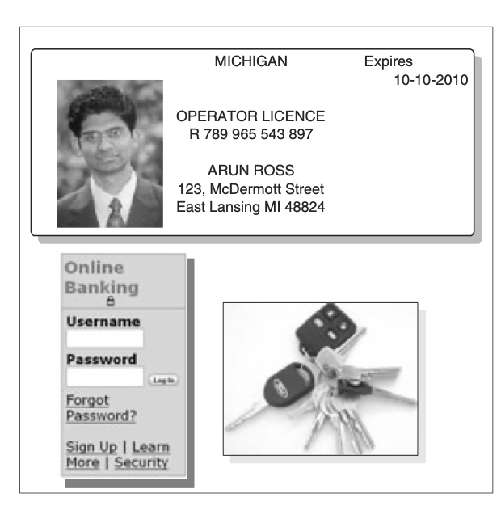
Traditional Identification: approaches
Knowledge-based (“something that you know”)
password
personal identification number (PIN)
Token-based (“something that you have”)
passport
driver’s license
ID card
credit card
keys
@Jain et al. Introduction to Biometrics
11

Slide 36
Traditional Identification: disadvantages
Knowledge-based: PIN’s, passwords: may be forgotten or guessed by the impostors
Token-based: tokens may be lost, stolen, forgotten, misplaced
often misused (e.g. PIN number on ATM card (25%))
unable to differentiate between an authorized person and an impostor
unable to satisfy security requirements of our e-connected information society
12

Slide 37
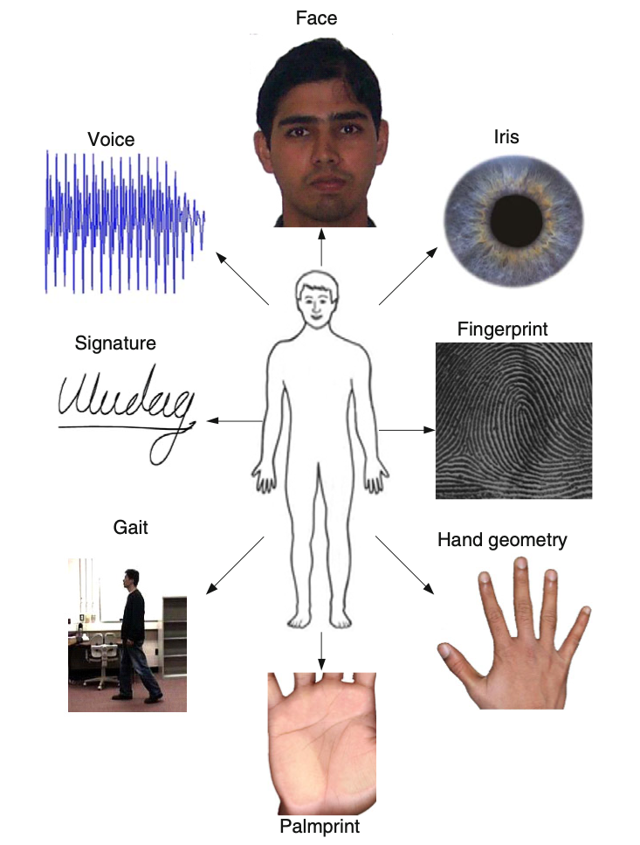
Biometric Identification
Associating an individual with an identity:
Something you have (extrinsically)
Token, smart card
Something you know
Password, pin
Something you are (intrinsically):
Physiological
Behavioral
@Jain et al. Introduction to Biometrics
13

Slide 38
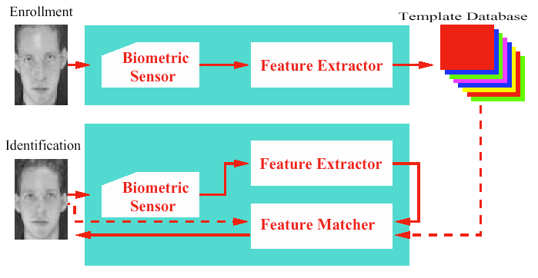
Biometric System Architecture
Basic modules of a biometric system:
Data acquisition
Feature extraction
Matching
Decision
Storage
14
Notes:
All biometric systems achieve automatic personal identification by comparing the biometric feature presented by a user with the stored feature of the claimed user. Regardless of the biometric feature being used, the biometric basic system architecture consists of the following logical modules:
data acquisition: captures the biometric data presented by the individual.
feature extraction: signal processing module that extracts and codes the distinguishing features from the biometric data.
matching: makes a statistical comparison between the extracted features and the reference data stored in the system.
storage: maintains the reference templates of the enrolled users.
decision: interprets the result from the matching module.
This model for a system architecture helps us to analyse the use of biometrics. However, there may be some systems where several of these components are integrated into one unit or are not even present (for example, some systems use raw biometric data for comparison and do not have the feature extraction module).

Slide 39
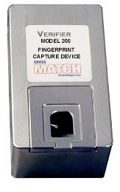
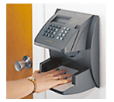
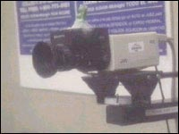
Data Acquisition Module
Reads the biometric info from the user.
Examples: video camera, fingerprint scanner/sensor, microphone, etc.
All sensors in a given system must be similar to ensure recognition at any location.
Environmental conditions may affect their performance.
©Luciano Rila/RHUL
15
Notes:
The data acquisition module contains the input device or sensor that reads the biometric information from the user. It is the link between the physical domain and the logical domain.
In order to recognise a user successfully, the sampled biometric characteristic must be similar to the user’s reference template to which it is compared. This imposes requirements on the data collection sensor, and may impose training requirements for the users. All sensors in a given system must be similar enough that a feature collected by one sensor will closely match the same feature collected at other sensors – and also that collected during enrolment – so that the user can be recognized at any location.
Depending on the biometric technology being used, environmental conditions such as lighting, background noise, weather, can impact on the performance of the data acquisition module.

Slide 40
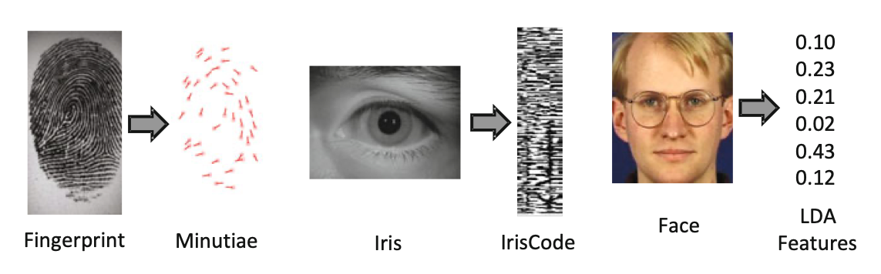
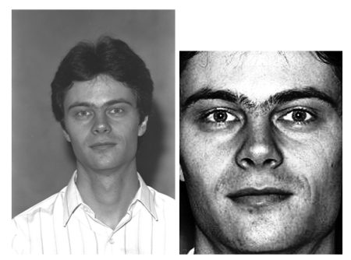
Feature Extraction Module
Distinguishing features extracted from the raw biometric data.
The most difficult part!
Raw data transformed into a small set of bytes – storage and matching.
Various ways of extracting the features.
Pre-processing (segmentation, enhancement) of raw data usually necessary.
@Jain et al. Introduction to Biometrics
©Luciano Rila/RHUL
16
Notes:
The feature extraction module receives the raw biometric data from the data acquisition module and extracts the distinguishing features from the raw data, transforming it into the form required for storage and matching. Even for the same biometric characteristic, there are various ways of extracting the distinguishing features. These are often proprietory.
This module may perform a quality analysis of the raw data to determine if it is satisfactory for use. If the data fails the quality test, the user may need to supply the biometric characteristic again.
The raw biometric data may be pre-processed prior to the feature extraction to remove noise or to be normalised in some way.
Typically, it is not possible to reconstruct the raw data from the extracted features.
Some biometric systems compare raw data, in which case this module is not required.

Slide 41
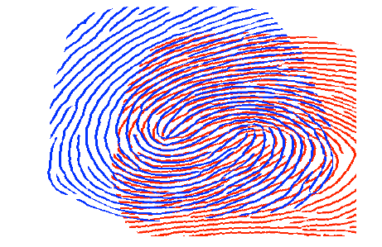
Matching Module
The core of the biometric system.
Measures the similarity of the claimant’s sample/query/probe/input with a template/reference.
Typical methods:
distance metrics (measures dissimilarity)
probabilistic measures (measures similarity)
The result: a number known as match score.
©Luciano Rila/RHUL
17
Notes:
The matching module receives the processed data from the feature extraction system and compares it with the biometric template from the storage module. The matching module has a key role in the biometric architecture.
The matching module measures the similarity of the claimant sample with a enrolled template. Each comparison yields a score, which is a numeric value indicating how closely the sample and the template match. There are different methods for computing the score and some typical examples are: distance metrics, probabilistic measures, and neural network-based methods.

Slide 42
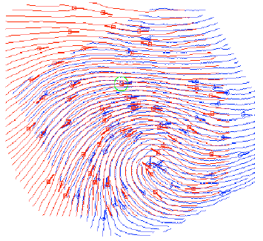
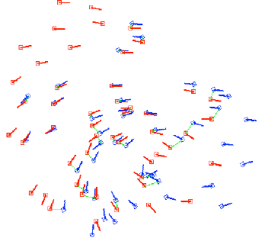
Decision Module
Interprets the match score from the matching module.
Typically a binary decision: yes or no.
May require more than one submitted sample to reach a decision: 2 out of 3.
May reject a legitimate claimant or accept an impostor.
©Luciano Rila/RHUL
18
Notes:
The decision module receives a score from the matching module and, using a confidence value based on security risks and risk policy, interprets the result of the score.
The decision module usually returns a binary yes or no. In the most common case, the decision is based on a single threshold. If the score is above the threshold, the module concludes that the user is indeed the individual owing the template. If not, the module indicates the user is not that individual. In more complicated cases, the decision is made based on more than one matches and a yes decision is taken if, for example, 2 out of 3 submitted samples match.
Note that it is possible that a legitimate claimant is rejected by the biometric system due to the very nature of the biometric data. The data acquisition module does not collect exactly the same biometric information at every attempt to use the system and so it is possible that a legitimate user is rejected or an impostor is admitted by the biometric system.

Slide 43
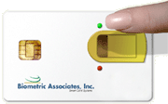
Storage Module
Maintains the templates for enrolled users.
One or more templates for each user.
The templates may be stored in:
a special component in the biometric device,
conventional computer database,
portable memories such as smartcards.
©Luciano Rila/RHUL
19
Notes:
The storage module maintains the reference templates for enrolled users. It may contain a single template for each user or thousands of templates depending on the system architecture or intended use.
The template may be physically stored in physically protected storage within the biometrics device, a conventional database on a computer, or in a portable token such as a smartcard.
Collateral information, such as name, identification number, etc, binding the owner to his/her reference template may also be stored together with the reference template.

Slide 44
Operational modes

Slide 45
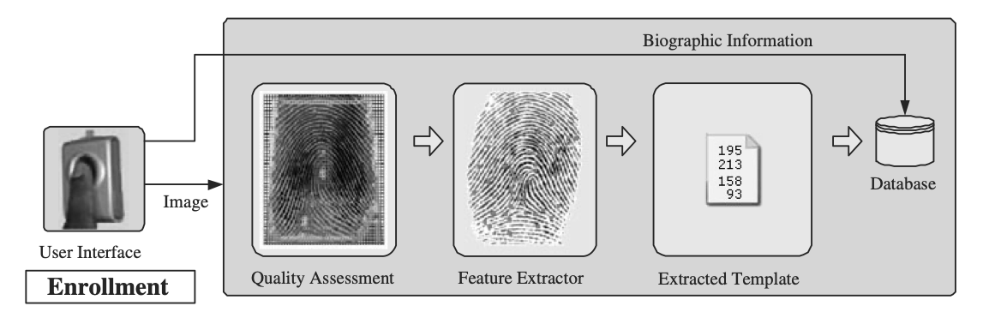
Enrollment
Capturing, processing and storing of the biometric template.
Crucial for the system performance.
Requirements for enrollment:
secure enrollment procedure,
check of template quality and “matchability”,
binding of the biometric template to the enrollee.
©Luciano Rila/RHUL
20
Notes:
Enrolment is the process of collecting biometric samples from a user and subsequent processing and storing of their biometric reference in the system database or portable token.
It is advisable for users to be enrolled at an authorised enrolment site. There must be verification that the reference template being recorded is that of the actual user. Collateral material binding the enrollee to their biometric template should be generated. It is also necessary to ensure that the recorded biometric template is able to properly verify the enrollee’s identity. A live matching of the enrollee’s reference template should be made before the template is stored in the system.
There are other considerations regarding the enrolment procedure. It should be ensured that the person performing the enrolment – the enroller – has the proper permission to access the enrolment functions, e.g. access control, command authentication, etc. It is also advisable to check if the enrollee has already been registered with the system and/or if a different enrolled user has a biometric template matching the current enrollee’s.

Slide 46
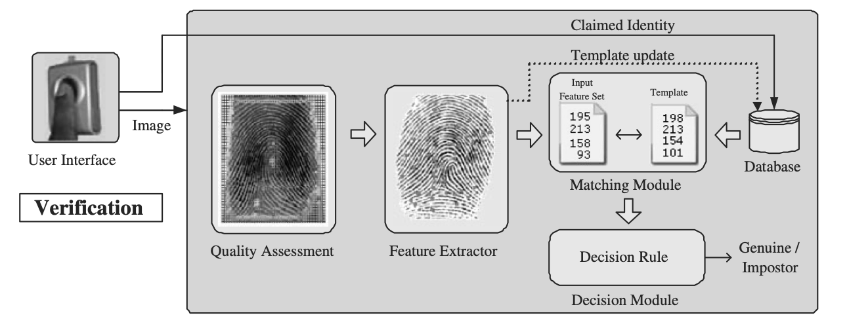
Operational Mode
Verification/authentication (1-to-1)
compares the captured biometric characteristics with the person’s template(s) stored in the system
identification by claiming identity (magnetic stripe card, login name, smart card)
system either rejects or accepts the submitted claim of identity
21

Slide 47
Verification as a 2-category classification problem

Slide 48
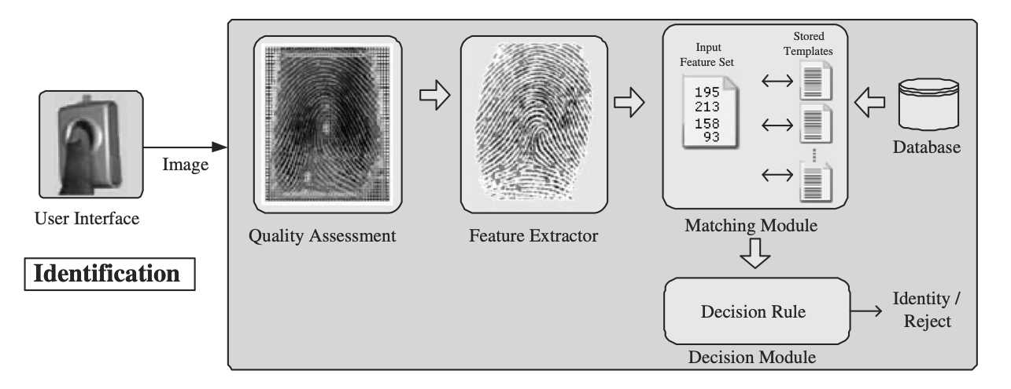
Operational Mode
Identification/Recognition (1-to-N)
recognize a subject by searching the entire template database for a match
subject’s identity is established by the system without the subject having to claim identity
21

Slide 49
Identification as an N+1 classification problem
Compare query to all enrolled templates
Output the identity of the person whose template has highest similarity
Or, decide that the user presenting the input is not an enrolled user.
Formally, given a query feature set x^{A}, we need to decide the identity I of the user, where I ∈ {I₁,I₂,··· ,I_{N},I_{N+1}}.
Here, I₁,I₂,··· ,I_{N} correspond to the identities of the N users enrolled in the system and I_{N+1} indicates the case where no suitable identity can be determined for the given query.
If x^{E}_{In} is the stored template corresponding to identity I_{n} and s_{n} is the match score between x_{A} and x^{E}_{In} , for n = 1,2,··· ,N, the decision rule for identification is,
where η is a pre-defined threshold.
Open versus closed set identification

Slide 50
Biometric Identifiers: Requirements
Universality
each person should have the characteristic
Uniqueness
no two persons should be the same in terms of the characteristic.
Permanence
the characteristic should neither change nor could be altered
Collectability
the characteristic can be measured quantitatively
22

Slide 51
Biometric System Requirements
Performance
achievable identification accuracy
speed
robustness
required resources
operational and environmental factors
Acceptability
the extent to which people are willing to accept a particular biometric identifier in their daily lives
Circumvention
how easy is it to fool the system by fraudulent methods
23

Slide 52
Performance
Speed
access-control: real-time
ATM: < 1sec
Forensic: less stringent
Storage
size of the template
number of templates/individual
compression
network bandwidth with large templates
Accuracy
24

Slide 53
Accuracy: ideal situation
The science of biometric recognition is based on two fundamental premises, namely, uniqueness and permanence of the underlying biometric trait.
Small inter-user similarity: a biometric identifier is said to be unique only if any two persons in the world can be differentiated based on the given identifier.
Small intra-user variations: a biometric trait is permanent if it does not change over the lifetime of an individual.

Slide 54
Accuracy: real situation
However, these two premises are seldom true in practical biometric systems.
Lack of uniqueness?: phenotypical (fingerprints) vs genotypical (DNA/face) features

Slide 55
Accuracy: real situation
However, these two premises are seldom true in practical biometric systems.
Permanence?: natural (ageing) changes and measurement variability

Slide 56
Performance measures
Biometric systems, being statistical classifiers, will (unfortunately) make recognition errors!
False positive (type I error = 1 - specificity): accepts (zero-effort) impostors
False Match Rate (FMR) = p(FP) = the proportion of zero-effort impostor attempt samples falsely declared to match the compared nonself template
Measure of distinctiveness (large variation over population)
False negative (type II error = 1 -sensitivity): does not recognize genuine identities
False Non-Match Rate (FNMR) = p(FN) = the proportion of genuine attempt samples falsely declared not to match the template of the same characteristic from the same user submitting the sample.
Measure of robustness (biometric unchanging over time/collections)
25
Notes:
Unfortunately, biometric characteristics are not exactly the same every time they are collected. Your voice changes depending on the time of day, your emotional state, or you simply don’t utter the same sentence EXACTLY the same way every time you do it. The fingerprint image captured by a sensor is not always the same because your finger may be greasy at one time and clean at another, the skin dryness changes or you simply put your finger on sensor in a slightly different position. And the list of biometrics features and why they are not the same every time they are collected goes on…
The matching module rates the similarity between the collected biometric data and the reference template. If the match score is above a tolerance (or confidence) threshold, the claimant is accepted. If it is below the tolerance threshold, the claimant is rejected. Biometric systems can therefore generate two types of errors:
Type I error: where the system fails to identify a valid user (‘false non-match’ or ‘false rejection’),
Type II error: where the system accepts an impostor (‘false acceptance’ or ‘false acceptance’).
The value of the tolerance threshold is crucial to the performance of the system and depends on the security requirements of the application. If the tolerance threshold is relatively low, more valid users are rejected (false non-match rate is low) but more impostors are accepted (false acceptance rate is high). On the other hand, if the tolerance threshold is relatively high, more valid users are rejected (false non-match rate is high) but less impostors are accepted (false match rate is low). There is a trade off between these two types of errors that depends on the security requirements of the application.
In any biometric scheme, the key parameter is the error tolerance threshold. If the tolerance threshold is relatively low, more valid users are rejected (false non-match rate is low) but more impostors are accepted (false acceptance rate is high). On the other hand, if the tolerance threshold is relatively high, more valid users are rejected (false non-match rate is high) but less impostors are accepted (false match rate is low). There is a trade off between these two types of errors that depends on the security requirements of the application.
The equal error rate is defined when the tolerance threshold is such that the false non-match rate is equal to the false match rate. It is usually used as a criterion to compare different biometric systems. The actual tolerance threshold is determined by the needs of the given application.

Slide 57
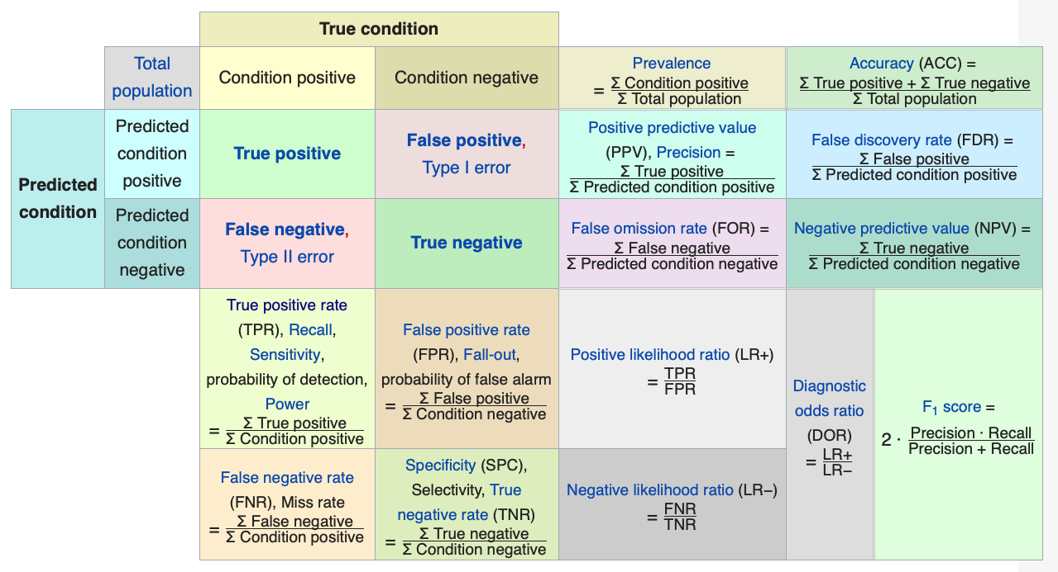
Interludium: from confusion matrix to confusing metrics

Slide 58
Verification system error rates
False Reject Rate (FRR) = False Non-Match Rate (FNMR)
False Acceptance Rate (FAR) = False Match Rate (FMR)
A match score is termed as a genuine or authentic score if it indicates the similarity between two mate samples. An impostor score measures the similarity between two non-mate samples. As discussed before, a verification system makes a decision by comparing the match score s to a threshold η.
Given a set of genuine and impostor match scores, FRR can be defined as the proportion of genuine scores that are less than the threshold η and FAR can be defined as the fraction of impostor scores that are greater than or equal to η.

Slide 59
Practical calculation
Given a fixed corpus of samples (N users, each with t (<<N) samples of a certain biometric identifier) collected under controlled conditions
Generate a genuine match score by comparing pairs of samples from the same user using the matcher
Generate an impostor match score by comparing pairs of samples from two different users using the matcher
# = (N(N − 1)t²)/2 >> # = N.t.(t − 1)/2

Slide 60
FAR and FRR from score distributions
Can you minimize both at the same time?
https://semiengineering.com/biometrics-for-the-iot/

Slide 61
FAR and FRR from score distributions
ω₀ impostor class
ω₁ genuine classes
Can you minimize both at the same time?

Slide 62
Detection Error Trade-off (DET) curve: FAR vs FRR
Detection error trade-off (DET) curve is the graph of FAR vs FRR obtained by varying the match threshold.
(Note: sometimes FRR is plotted vs FAR …)
https://semiengineering.com/biometrics-for-the-iot/

Slide 63
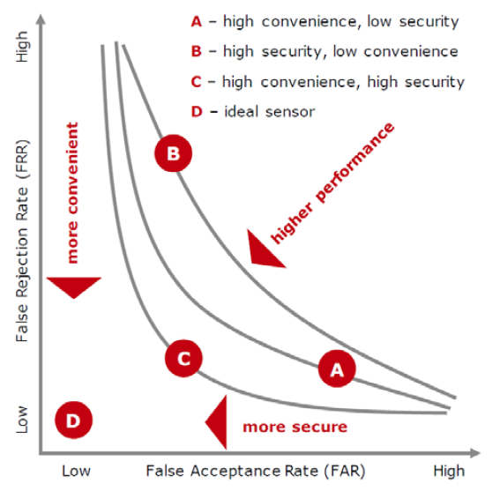
Detection Error Trade-off (DET) curve: FRR vs FAR
Detection error trade-off (DET) curve is the graph of FAR vs FRR obtained by varying the match threshold.
(Note: sometimes FRR is plotted vs FAR …)

Slide 64
DET and ROC curves
Detection error trade-off (DET) curve, which is the graph of FRR vs FAR, which is obtained by varying the system parameters such as match threshold
Receiver operator characteristic (ROC) curve, which is similar to DET curve, but plots TAR (= 1- FRR) against FAR
FRR (1- sensitivity/recall) vs FAR (1-specificity)
TAR (sensitivity/recall) = 1- FRR vs FAR (1-specificity)

Slide 65
Three very important points to note
It is possible to attribute any FMR to any biometric, as the decision threshold criterion sweeps out its path from extremely conservative (“reject everyone,” ensuring that FMR = 0%), to extremely liberal (“accept everyone,” making FMR = 100%).
As the ROC curves approach either of their corner limits, all biometrics converge, and look roughly comparable. They look equally accurate when high FMRs (e.g. 0.001) are tolerated.
What is most important is the flatness of any ROC curve, (slope = likelihood ratio), since this reveals the extent to which the FMR can be reduced without much (or any) cost to FnMR.
Daugman J (2007) Evolving methods in iris recognition. V
IEEE International Conference on Biometrics: Theory, Applications, and Systems, (BTAS07),
http://www.cse.nd.edu/BTAS_07/John_Daugman_BTAS.pdf.

Slide 66
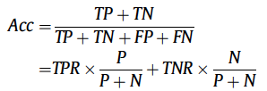
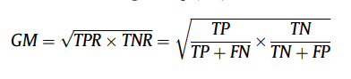
Accuracy or error rate
Since verification is a binary classification problem, why not reporting
classification accuracy
or error rate = (1- accuracy)
as performance measure?
Hint: count number of genuine pairs and imposter pairs
What about the Geometric Mean of TPR and TNR?
What about sensitivity and specificity in this regard?
sensitivity
specificity
Notes:
Different assessment methods are sensitive to the imbalanced data when the samples of one class in a dataset outnumber the samples of the other class(es) [25]. To explain this is so, consider the confusion matrix in Fig. 1. The class distribution is the ratio between the positive and negative samples () represents the relationship between the left column to the right column. Any assessment metric that uses values from both columns will be sensitive to the imbalanced data as reported in [8]. For example, some metrics such as accuracy and precision¹ use values from both columns of the confusion matrix; thus, as data distributions change, these metrics will change as well, even if the classifier performance does not. Therefore, such these metrics cannot distinguish between the numbers of corrected labels from different classes [11].

Slide 67
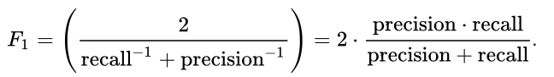
Precision-Recall curves
Precision (positive predictive value (PPV)
PPV = TP/(TP+FP)
the fraction of the positives detected that are actually correct
as it combines results from both positive and negative samples, it is class prior dependent!
Recall (TPR or sensitivity)
the probability of correctly detecting a positive test sample
it is only dependent on positive samples and hence independent of class priors
F1-measure or score [0,1] is the harmonic mean of precision and recall:
the Harmonic Mean penalizes the extreme values

Slide 68
ROC vs PR curves
While the baseline is fixed with ROC, the baseline of [precision-recall curve] is determined by the ratio of positives (P) and negatives (N) as y = P / (P + N).
For instance, we have y = 0.5 for a balanced class distribution …

Slide 69
When to Use ROC vs. Precision-Recall Curves?
In a general binary classification context, the recommendations for use of ROC curves and PR curves are:
ROC curves should be used when there are roughly equal numbers of observations for each class.
PR curves should be used when there is a moderate to large class imbalance.
Why? ROC curves present an optimistic picture of the model on datasets with a class imbalance, because of the use of true negatives in the False Positive Rate in the ROC Curve and the careful avoidance of this rate in the Precision-Recall curve.
In a verification testing scenario we have a highly imbalanced set (imposter pairs vastly outnumber the genuine pairs). Do the above recommendations still hold?

Slide 70
Verification performance numbers
FAR for fixed FRR
FRR or true acceptance rate (TAR = 1 - FRR), at fixed FAR
Equal error rate (EER), operating point where FAR = FRR
Area Under the Curve (AUC): area under the ROC curve ([0.5,1])

Slide 71
Comparing AUC and ROC
In this example the AUC of classifier B is greater than A; hence, it achieves “overall” better performance.
The grey area is common in both classifiers, while the red area represents the area where classifier B outperforms classifier A.
It is possible for a lower AUC classifier to outperform a higher AUC classifier in a specific region.
In this example, the classifier B outperforms A except at FPR > 0.6 where A has a slight difference (blue shaded area).
Two classifiers with two different ROC curves may have the same AUC score.

Slide 72
Verification performance numbers
d-prime value (also called Cohen’s d)
The d-prime value (d′) measures the separation between the means of the genuine and impostor probability distributions in standard deviation units and is defined as
where μ₁ (μ₀) and σ₁ (σ₀) are the mean and standard deviation, respectively, of the genuine (impostor) score distributions.

Slide 73
Identification system error rates
Identification rank is the rank of a user’s correct identity in the list of returned identities ranked according to decreasing similarity with the query by the identification system.
For instance, if a user’s correct identity corresponds to the topmost match (highest score among all N match scores), we say that the user has been identified at rank one.
The false positive identification rate (FPIR) is the expected proportion of identification transactions by users not enrolled in the system, where an identity is returned. The FPIR depends both on the size of the enrolment database (N) and the threshold (η)
The true positive identification rate (TPIR) is the expected proportion of identification transactions by users enrolled in the system, where the user’s correct identity is among the t identities returned by the system. FPIR depends on the size of the enrolment database (N), the threshold (η) used for the match scores, and the number of identities t returned by the identification system. TPIR is also called the rank-t identification rate R_{t}

Slide 74
Cumulative Match Characteristic (CMC) curve
The Cumulative Match Characteristic (CMC) curve plots the rank-t identification rate R_{t} against t for t = 1,2,··· ,N, where N is the number of enrolled users.

Slide 75
Caveat: FMR (verification) versus FPIR (identification)
While an FMR of 10⁻⁶ (1 false match in 1 million attempts) is typically acceptable in the verification mode,
The FPIR of an identification system with 10.000 enrolled users using the same matcher under the same threshold setting η would be about 1%!
Suppose that such an identification system is used at an airport to screen passengers against a watch-list of 10.000 per-sons, 1 in 100 innocent passengers would be falsely matched against someone from the watch-list, causing inconvenience and potential embarrassment.

Slide 76
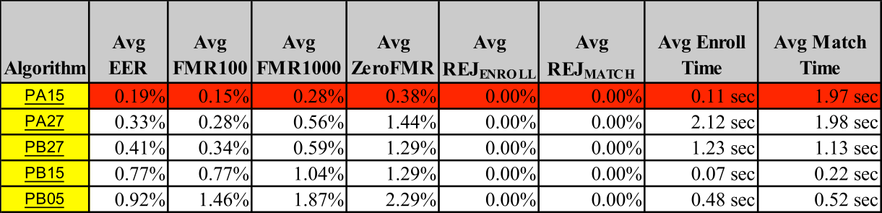
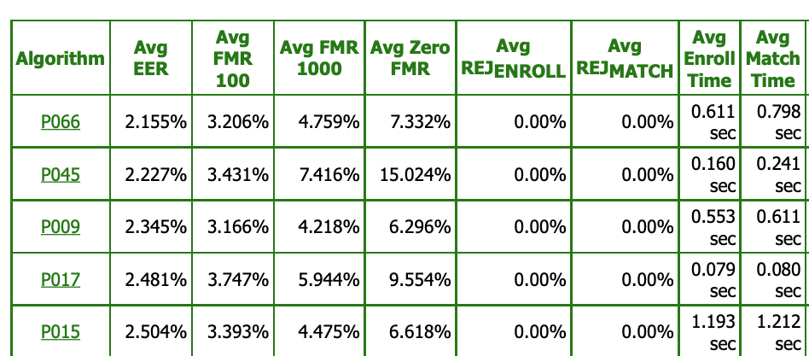
Degradation of algorithms over time?
Test 2002
Test 2006

Slide 77
Note: dependence on test data base!
Fixed corpus of samples collected under controlled conditions

Slide 78
User-dependent FA and FR behaviour
It is important to note that the occurrence of false accepts and false rejects is not evenly distributed across the users of a biometric system. There are inherent differences in the “recognizability” of different users.
Four categories of users are usually defined in the biometrics literature based on these inherent differences.
sheep: concerns users who can easily be recognized (low FAR and FRR)
goats: represents users who are particularly difficult to recognize (high FRR)
lambs: contains users who are easy to imitate (high FAR)
wolves: consists of users who can easily imitate others (increases FAR)

Slide 79
Doddington’s zoo menagerie
Houmani N., Garcia-Salicetti S.On hunting animals of the biometric menagerie for online signature PLoS One, 11 (4) (2016), Article e0151691

Slide 80
Doddington’s zoo (extended definition)
Sheep represent users whose biometric feature sets are very distinctive and exhibit low intra-class variations. Therefore, these users are expected to have low false accept and false reject errors.
Goats refer to users who are prone to false rejects. The biometric feature sets of such users typically exhibit large intra-class variations.
Lambs are users whose biometric feature set overlaps extensively with those of other individuals. The biometric feature sets of these users have high inter-user similarity. Thus, a randomly chosen user (from the target population) has a higher probability of being accepted as a lamb than as a sheep. The false accept rate associated with these users is typically high.
Wolves indicate individuals who are successful in deliberatel ymanipulating their biometric trait (especially behavioral traits) in order to impersonate legitimately enrolled users of a system. Since the wolves make a concerted effort to adopt the identity of another user, such an effort is often referred to as an adversary attack and it can increase the FAR of a system. Examples include forging the signature of another user or mimicking someone else’s voice. This is in contrast to a zero-effort attack, where the biometric traits of an opportunistic intruder may be sufficiently similar to a legitimately enrolled user.

Slide 81
Other quantitative measures: availability
Failure to enroll rate (FTE)
the probability that a user will not be able to supply a readable measure to the system upon enrolment
Failure to acquire/capture rate (FTA, FTC)
The device is not able to locate a biometric signal of sufficiently good quality (e.g., an extremely faint fingerprint or an occluded face image)
Sensor wear and tear
Examples:
Too dark for face recognition
Dirty fingerprint reader
Background noise for voice recognition

Slide 82
Other quantitative measures
Accessibility
Throughput rate
the number of individuals that can be processed in a unit time, such as a minute or an hour
Acceptability
people do not object to having this measurement taken from them?
Measured by polling the device users

Slide 83
Costs
Sensors
inexpensive (e.g. microphones)
almost standard PC peripheral (camera)
solid state technology ⇒ cost(sensors) ↓, e.g. fingerprint sensors
Storage
28

Slide 84
Human factors
Comfort, user-friendliness
+: face, voice, iris (non-contact)
Requiring little cooperation/participation
+: faces, facial thermograms
public acceptance:
threat to individual privacy
29

Slide 85
Example of biometrics systems

Slide 86
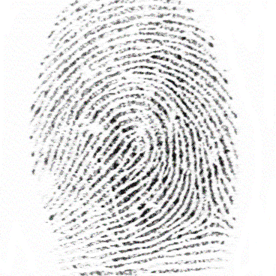
Fingerprint recognition
Fingerprint = pattern of ridges and furrows on the surface of a fingertip
Fingerprint shape is determined during fetal period
Fingerprints of identical twins are different
No correlation between prints of different fingers of the same individual
Most understood and studied biometric
Used for centuries
validity well-established
With solid state sensors => incorporation in many applications
Acceptability? Because of association with criminal investigations
34

Slide 87
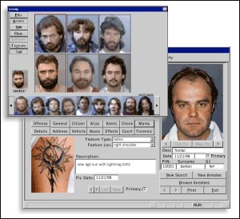
Face recognition
Face recognition is the means by which people have recognized one another since the beginning of civilization.
“Now, computers have the ability to recognize faces too.”

Slide 88
Face Recognition Subtasks
Face detection Detects single or multiple faces even in complex scenes
Segmentation Crops faces from background
Faceprint Generates digital code or internal template unique to an individual
Face Recognition Functions in either of the following:
One-to-one matching: Authentication
One-to-many matching: Identification
Tracking Follows faces over time
Compression Compresses facial images down to 84 bytes in size
32

Slide 89
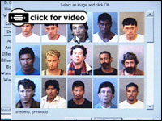
Examples
A person's face can be very expressive- and now, more than ever. Toronto's Pearson International Airport is employing a controversial face-recognition security system to identify criminal suspects. Casinos have also adopted the technology to keep track of cheaters.
It's a new application for "biometrics"- technology that identifies individuals based on specific biological traits. Fingerprints and iris sensors are used in ATM's, for logging onto corporate networks and in many other applications.
Imagis Technology of Vancouver is the company responsible for Pearson's set-up. CEO, Iain Drummond explains how the system works in @discovery.ca's interview.
© 2953285 Canada Inc. cob Discovery Channel Canada 2000. All rights reserved.
Biometrics System Concepts (Course HJ59, K.U.Leuven) – D. Vandermeulen – Introduction
33

Slide 90
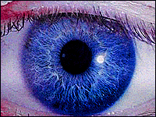
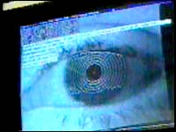
Iris recognition
Iris = annular region of the eye bounded by pupil and sclera (white of the eye)
Texture establishes very early (first 2 years)
Complex structure with very distinctive information useful for identification
each iris is unique
irises of identical twins are different
user-friendly and cost-effective systems are underway
difficult to surgically tamper iris texture information
easy to detect artificial irises
35

Slide 91
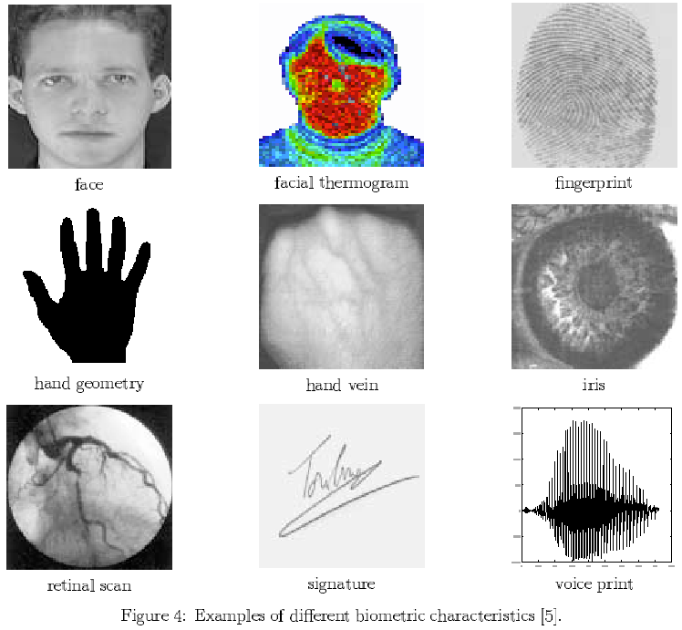
Retinal pattern
The pattern formed by veins beneath the retinal surface
Stable and unique
Digital images acquired by projecting a low-intensity beam of visual or infra-red light into the eye
Identification accuracy is very accurate
High degree of user cooperation/involvement required
Currently perceived to be the most secure biometric system
Retinal scanners are expensive
40

Slide 92
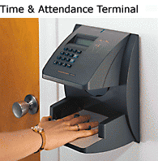
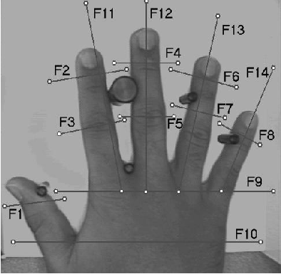

Hand recognition
36
Notes:
Every hand is unique. Hand geometry scanners such as those made by RSI take over 90 measurements of the length, width, thickness, and surface area of the hand and four fingers--all in just 1 second. The technology uses a 32,000-pixel CCD digital camera to record the hand's three-dimensional shape from silhouetted images projected within the scanner. The scanner disregards surface details, such as fingerprints, lines, scars, and dirt, as well as fingernails, which may grow or be cut from day to day. When a person uses the scanner, it compares the shape of the user's hand to a template recorded during an enrollment session. If the template and the hand match, the scanner produces an output--it may unlock a door, transmit data to a computer, verify identification, or log the person's arrival or departure time.
During enrollment, which takes approximately 30 seconds, the user places the right hand in the reader three times. The unit's internal processor and software convert the hand image to a 9-byte mathematical template, which is the average of the three readings. The user's template may reside in internal memory (capable of holding over 27,000 users), or on other media such as a hard disk or smart card chip.
RSI significantly enhanced biometric technology for its hand scanners. By maintaining a low False Reject Rate (the probability that the device will reject an authorized user), while maintaining a high deterrent to unauthorized access, RSI's units process large numbers of people with minimal delays. The crossover of False Reject and False Accept rates for RSI's hand geometry readers is 0.1%. These optimal error rates were documented in independent testing at Sandia National Laboratories. Subsequent field results from thousands of users and hundreds of thousands of transactions confirmed the Sandia findings. Among biometric technologies, Sandia reported that hand geometry had the highest user acceptance of all devices tested. With a high level of security, ease of use, and non-threatening technology, hand geometry has become the most widely accepted biometric technology in use today.

Slide 93
Hand recognition
Shape, length, width of fingers etc.
Installed in thousands and thousands of locations around the world
Very simple
Relatively easy to use
Inexpensive
Operational environmental factors (e.g. dry weather) or individual anomalies (e.g. dry skin) have virtually no negative effect on identification accuracy
Acceptance is high
Main disadvantage: low discriminative power: high identification accuracy difficult for a large population
Hand shape not invariant during life span (especially during childhood)
Physical size of devices is rather large
37

Slide 94
Signature
Each person has a unique style of writing
No two signatures of a person are exactly identical
Variations also depend on physical and emotional state
Authentication accuracy is reasonable, but not sufficiently high for large scale identification
High user acceptance
Two approaches:
Static: uses only the geometric shape features of a signature
Dynamic: uses additionally dynamic features such as acceleration, velocity, trajectory profiles
Dynamics information difficult to mimick by impostors
38

Slide 95
Speech
Characteristics determined by the size/shape of the appendages (vocal tracts, mouth, nasal cavities, lips) synthesizing the sound
Speech of a person is distinctive but not sufficient for identification
Two strategies:
Text dependent: utterance of a fixed predetermined phrase
Text-independent: offers more protection against fraud
General acceptance
Sensitive to a number of factors:
Background noise
Emotional and physical state of the speaker
Mimicking other’s voices? => Perceived to be low-security
39

Slide 96
Ear recognition

Slide 97
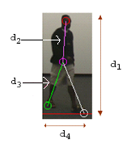
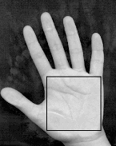
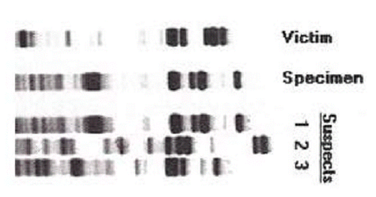
Other Biometric Techniques
Palmprint
Hand vein
DNA
Ear shape
Keystroke dynamics
Fingernail bed
Body odor
Gait
42

Slide 98
Multi-modal biometrics

Slide 99
Multi-modal biometrics

Slide 100
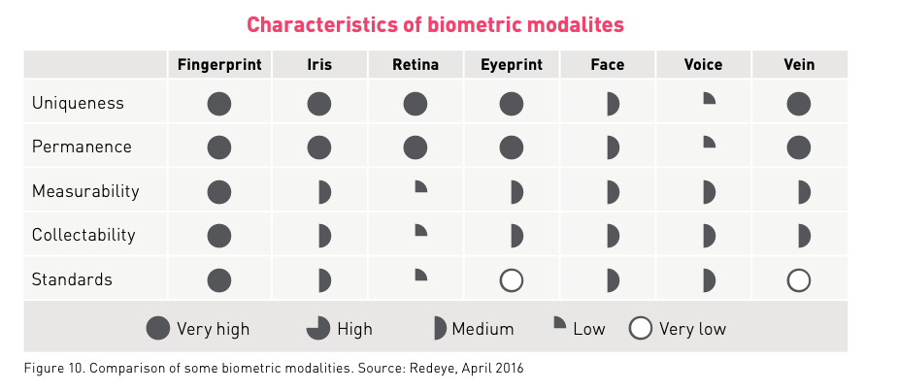
Comparison of Biometrics Technologies
https://www.fingerprints.com

Slide 101
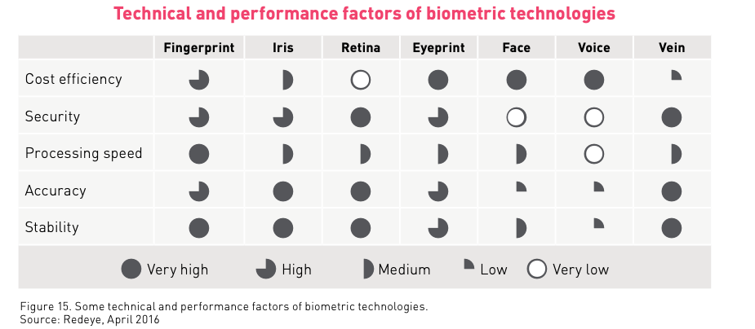
Comparison of Biometrics Technologies
https://www.fingerprints.com

Slide 102
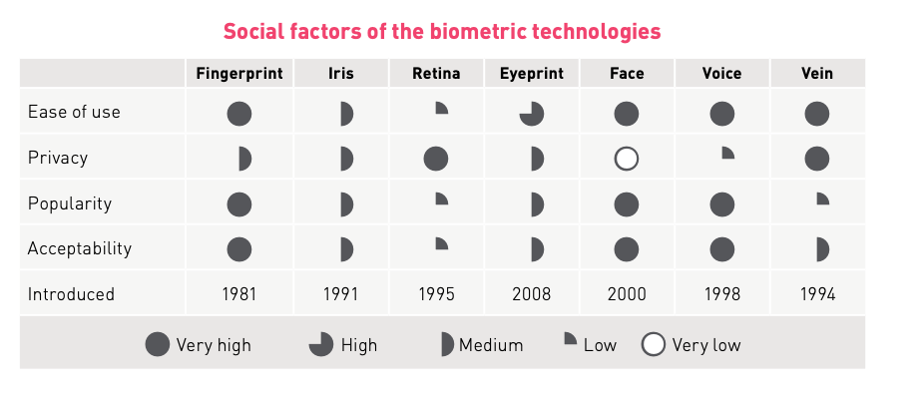
Comparison of Biometrics Technologies
https://www.fingerprints.com

Slide 103


Slide 104
https://www.marketsandmarkets.com/

Slide 106



Market potential
1.5BN
1.7BN
6-8BN
MOBILE
ACCESS²
PAYMENT¹
¹ Payment devices = Payment cards, wearables, USB dongles/tokens. Potential addressable market in a few years.
² Personal access devices for physical and logical access = smart doorlocks, tap locks, access cards/fobs, remote controls, game controls, USB dongles/tokens/crypto wallets for logical access, smart suitcases, connected cars, printers, routers, smart homes /alarm panels

Slide 107
















Biometrics has achieved huge success in mobile
USED FOR

Slide 108

Comparison of Biometrics Technologies
43

Slide 109


literature
See also electronic references on Toledo
44

Slide 110
Biometrics on the silver screen
From facial recognition to DNA identification, biometric technology has been appearing in movies since the 1960s. This infographic takes a look at just some examples of how biometrics have been used in films and explores the fact behind the fiction.

Slide 111

Biometrics Syllabus
PART I BACKGROUND
Introduction
Basic pattern recognition aspects
Part II APPLICATIONS
fingerprints
facial recognition
iris scanning
retina scanning
hand geometry
voice verification
signature verification
Others (ear biometrics)
Multimodal biometrics
Part III Implementation and security issues
46

Slide 112
Biometrics evaluation
Assignment based (tentative schedule)
0. Intro (not-graded)
installation of Python and OpenCV
Use of Jupyter Lab (Notebooks)
1. Setting up a verification and identification scenario (graded)
2. Minutiae-based fingerprint recognition (graded)
3. Face Recognition using PCA/LDA/LBP (graded)
4. Face Detection using CV and DL(graded)
5. Face Recognition using DL (graded)
Submit Jupyter Notebooks (mixing code and text) to present at examination

